Slide 1


Usability testing on Kdenlive and OpenShot
Tuğrul YATAĞAN | 040100117
Emre GÖKREM | 040100124
Gökberk GÜLGÜN | 040100135

Slide 2
Motivation
Multimedia is common area for information age
Companies need employees with knowledge in video editing
There are many different video editing tools
Selection between video editing tools is HARD!

Slide 3
Purpose
Aim of the study is usability of most popular open source video editing tools OpenShot and Kdenive
Reasons for choosing OpenShot and Kdenlive
Very popular
Large community
Free software

Slide 4
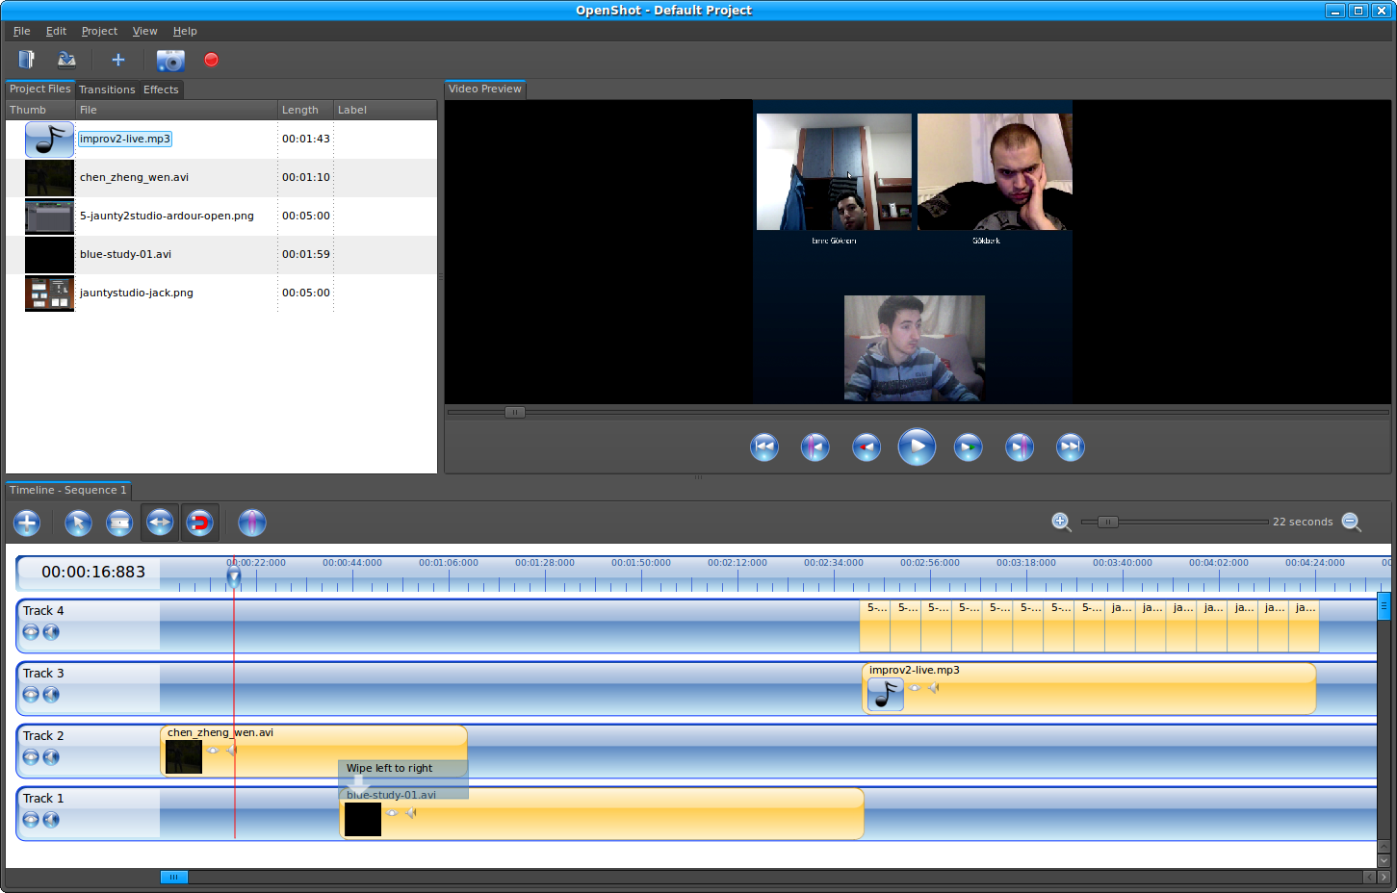
OpenShot
Figure 1: OpenShot Screenshot

Slide 5
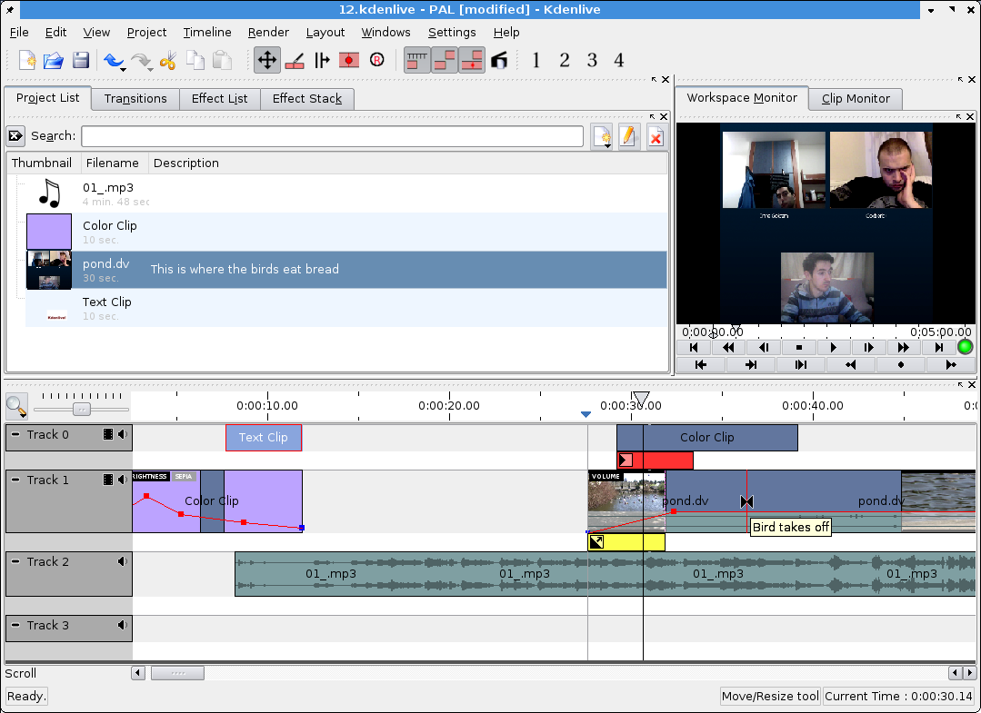
Kdenlive
Figure 2: Kdenlive Screenshot

Slide 6
Tasks
Requirement analysis
Planning of processes
Selection of participants
Defining methods
Participant feedback
Task execution
Software survey
Progress report
Preparation of document
Presentation
Final report

Slide 7
Methods
Software survey
Task execution
Participant feedback

Slide 8
Software Survey
20 participant
Participant criteria:
Experience with video editing
Expertise level
Used OpenShot or Kdenlive
Computer engineering student

Slide 9
Software Survey – Weights
Figure 3: Survey Activity Weights

Slide 10
Software Survey – Prior Knowledge
Figure 4: Prior Knowledge

Slide 11
Task Execution
Quantitative time based effort analysis
Considered criteria:
Montage (Cut, Copy, Paste)
Video Effect
Audio Effect
Toolbar Navigation

Slide 12
Task Execution – Montage
Montage actions: Cut, Copy, Paste
Figure 5: Box Plot of OpenShot and Kdenlive on Montage

Slide 13
Task Execution – Audio Effect
Figure 6: Box Plot of OpenShot and Kdenlive on Audio Effect

Slide 14
Task Execution – Video Effect
Figure 7: Box Plot of OpenShot and Kdenlive on Video Effect

Slide 15
Task Execution – Toolbar Navigation
Figure 8: Box Plot of OpenShot and Kdenlive on Toolbar Navigaton

Slide 16
Participant Feedback
Considered criteria:
Learnability
Flexibility
Overall
Compatibility
Consistency
User guidance

Slide 17
Participant Feedback - Learnability
Figure 9: Participant Feedback Learnability

Slide 18
Participant Feedback - Flexibility
Figure 10: Participant Feedback Flexibility

Slide 19
Participant Feedback - Overall
Figure 11: Participant Feedback Overall

Slide 20
Final Analysis & Results and Final Evaluation

Slide 21
Conclusion
We have done software survey, task execution and participant feedback
In task execution and participant feedback, OpenShot performed better overall
Openshot has an easy to use, learnable but Kdenlive has flexible interface
For easy and fast development,
we recommend Openshot!

Slide 22
THANK YOU FOR LISTENING!
ANY QUESTIONS?

Slide 23
Referances
H. R. Hartson, T. S. Andre, and R. C. Williges, “Criteria For Evaluating Usability Evaluation Methods,” Int. J. Hum.-Comput. Interact., vol. 13, no. 4, pp. 373–410, 2001
OpenShot Features Web Page, OpenShot, http://www.openshot.org/features/
Kdenlive Features Web Page, Kdenlive, https://kdenlive.org/features

